Slide 1




team member: 주민식, 김예성
Introduction to the C Programming Language
A Foundational Programming Language

Slide 2

Table of Contents
01
02
03
History and Development of C
Core Features and Characteristics
C Language Syntax Fundamentals
04
05
Memory Management in C
C's Influence on Modern Programming

Slide 3


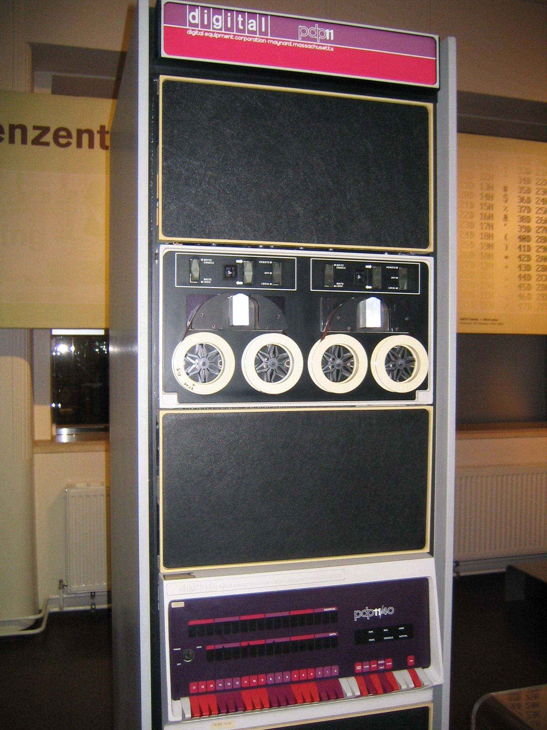

The Birth and Evolution of C Language
History
of C
- Created by Dennis Ritchie at Bell Labs in the early 1970s
- Evolved from the B programming language, which was developed by Ken Thompson
- Initially developed for the Unix operating system on the PDP-11 computer
- First standardized as ANSI C in 1989 (X3.159-1989)
- Later adopted by ISO as ISO/IEC 9899:1990
- Major revisions include C99 (1999), C11 (2011), and C17 (2018)
- Designed to be a portable, efficient, and flexible language for system programming

Slide 4



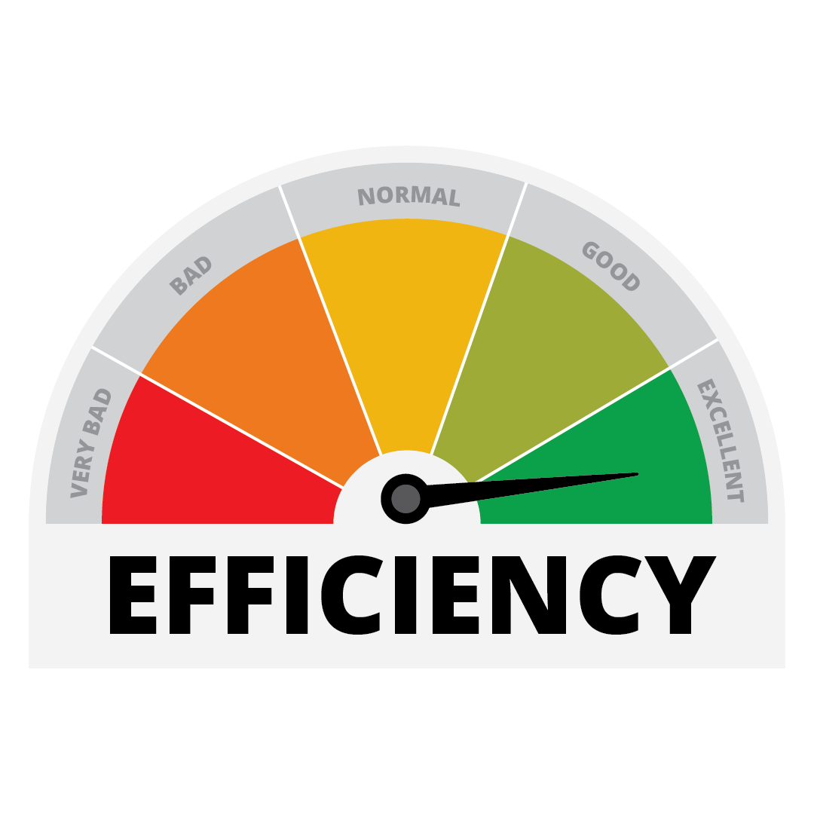


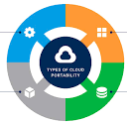




Core Features
Low-Level
Efficiency
Portability
- Direct memory access
- Pointer arithmetic
- Bit manipulation
- Hardware interaction
- Minimal abstraction
- System-level programming
- Small runtime footprint
- Minimal overhead
- Predictable performance
- Close to assembly
- Optimized compilation
- Fine control
- Write once, compile anywhere
- Platform independennce
- Standardized language
- Consistent behavior
- Wide compiler support
- Cross-platform development

Slide 5
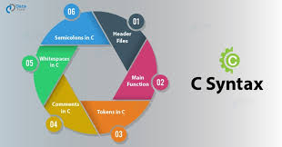


Syntax Basics
Control Structures
- if-else conditionals
- for, while, do-while loops
- switch-case statements
- break and continue
Data Types
Operators
Functions
- int, float, double, char
- Arrays and pointers
- structs and unions
- typedef for custom types
- Arithmetic: +, -, *, /, %
- Logical: &&, ||, !
- Bitwise: &, |, ^, ~, <<, >>
- Function declarations
- Return types and parameters
- Call by value semantics
- Function pointers

Slide 6


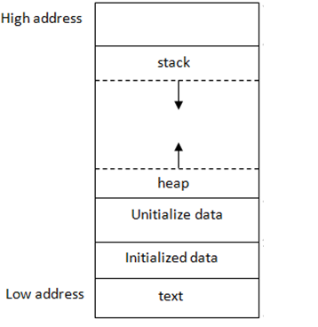


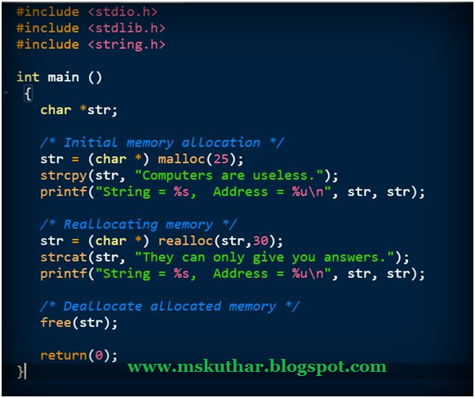
Memory in C
Stack vs. Heap Allocation
- Stack: Automatic, fast allocation
- Fixed size determined at compile time
- Local variables stored her
- Memory freed automatically when out of scope
Dynamic Memory Functions
- malloc(): Allocates requested bytes
- calloc(): Allocates and initializes to zero
- realloc(): Resizes allocated memory
- free(): Releases allocated memory

Slide 7


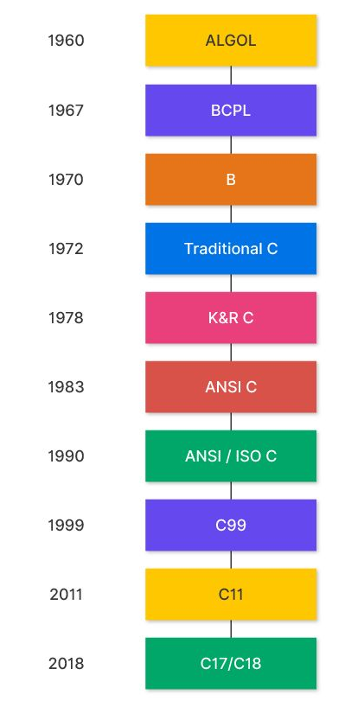




C's Influence
Derivatives
Systems
Design
- C++ extends C
- Objective-C
- C# influenced
- Java syntax
- Unix/Linux
- Windows
- Embedded
- IoT devices
- Influenced Go
- Rust safety
- Python's C API
- Low-level access
C remains foundational in modern computing, influencing countless languages and powering critical systems worldwide.

Slide 8



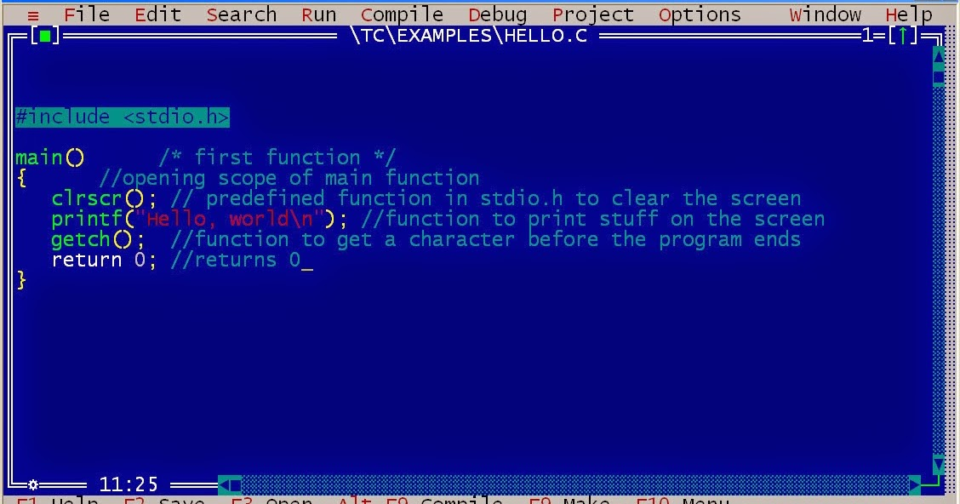
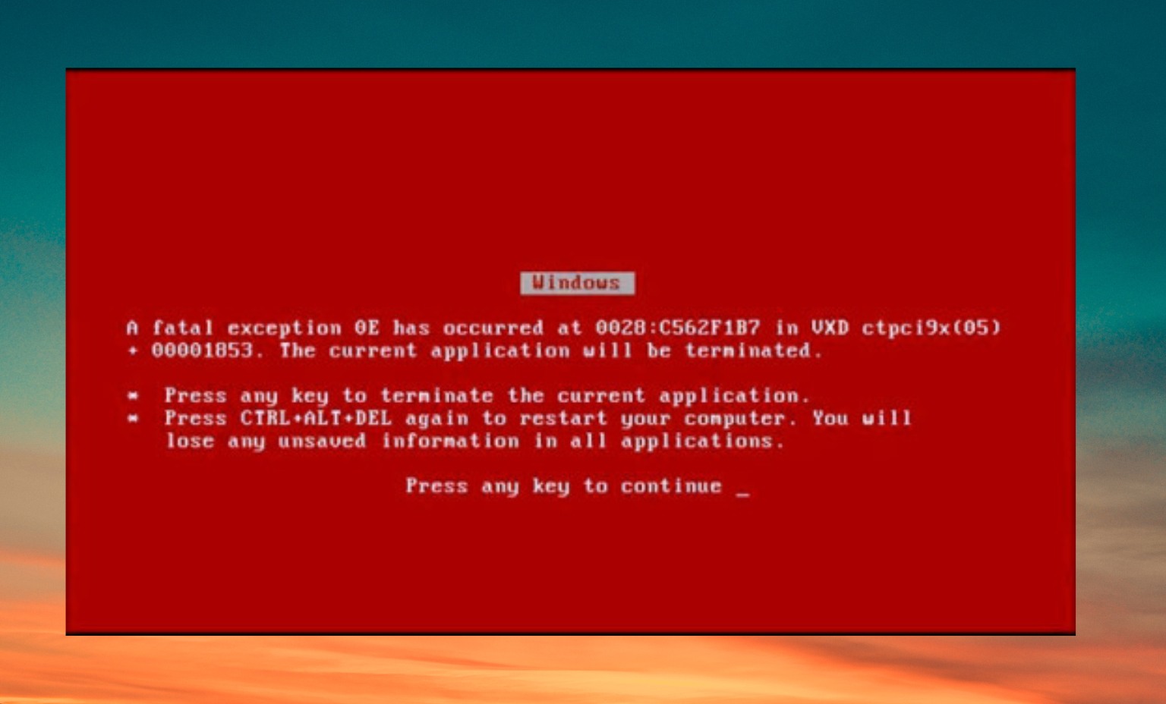

C: Pros & Cons
Strengths of C
Limitations of C
- High performance and efficiency
- Portability across platforms
- Low-level memory access
- Small runtime footprint
- Manual memory management
- Prone to buffer overflows
- Limited built-in safety features
- Lacks modern abstractions

Slide 9


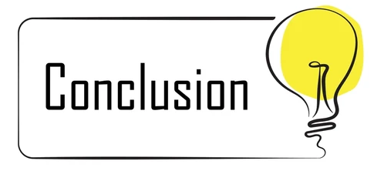
Conclusion
Even after more than 50 years, the C language remains at the heart of computing.
Its design has shaped modern programming languages and continues to power
operating systems, embedded devices, and performance-critical software.
While newer languages focus on simplicity and safety,
C’s efficiency, speed, and control still make it irreplaceable
for engineers who build the foundation of modern technology.

Slide 10


Conclusion

